Slide 1
Week 6 Advanced SQL Outer Joins and Sets
IN705 Databases 3 - 2018

Slide 2
Topics
Complex Joins
Set Operations
Case Statement
Notes:
Some of these are review

Slide 3
Complex Joins
http://www.ibm.com/developerworks/data/library/techarticle/purcell/0112purcell.html
Notes:
You will have learned how to join in DB2, but there are more complex joins than the ones you learned there
First we will briefly review the need for and syntax of joins, then we will talk about how they are implemented by the system
This will help you to understand the more complex joins we will introduce today
This is a good article. It’s written for IBM’s DB2 database.

Slide 4
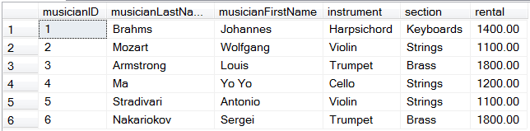
Join Review
SELECT
musicianID,
rental
FROM tblOrchestra
Notes:
Let’s think about this table, and here it is with some data
This is an easy table to query. For example, if you want to know what instrument someone plays, or what section they are in, or how much their rental is, it’s just a simple SELECT f1,f2, FROM tblOrchestra.
But when we talked about relational database design, we saw that this structure has some serious problems
Specifically, there is redundancy. The instrument information has to be repeated, and that can lead to errors. It would be possible, for example, to change the rental one violin player is charged without changing the others. The database as built here would permit that.
We further learned that the solution is to normalise the table to eliminate the redundancy.
Then it might look like this....

Slide 5
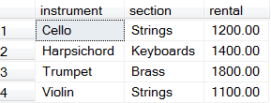
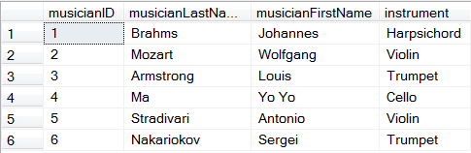
Join Review
Notes:
Now we’ve eliminated the redundancy and the risk of data corruption, but the query process has become more complicated
Specifically, what we took apart, we now have to put back together.
This process, as you know, is called a join
For example, now how would you list each musician and his rental charge?

Slide 6
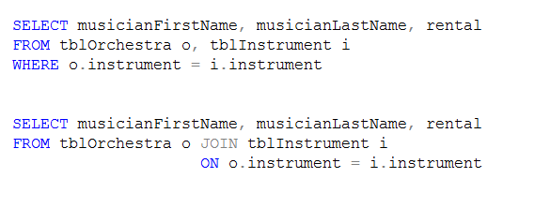
Join Review
Notes:
These two syntactic variations return exactly the same result (names and rental charges)
The second is the older, and now deprecated syntax for joining two tables
The second syntax, which explicitly states the join, is generally preferred.
It is more modern, and has several important technical advantages. The most important are:
It is clearer in the sense that it will always explicitly name all involved tables
It is unambiguous. For some of the more complex joins, you can’t get the result you want with the WHERE syntax

Slide 7

Join Review
Notes:
We expand our table a little bit to include Performances
Musician and Performance have a many to many relationship, so we get this little linking table
How can you list all the performers who played in the concert in Berlin, with the section they play in?

Slide 8
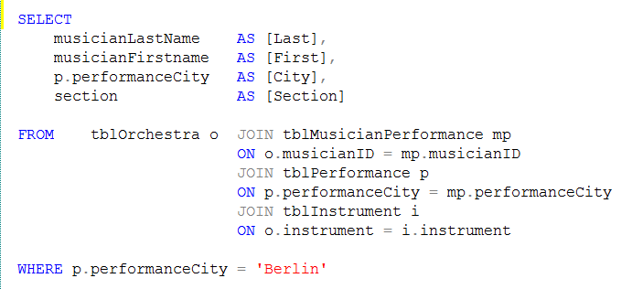
Join Review
Notes:
This is the end of the inner join review.
Next discuss how joins work (cartesian product and exclusion) then outer joins

Slide 9
Join Mechanics
INNER JOIN
Build Cartesian product of the two tables
Keep only those records that satisfy the ON condition
Notes:
To understand how the more complex joins work, it is very helpful to see the underlying process that the relational algebra uses to compute a join
NB: not always implemented this way in hardware; this is a definitional perspective. Sometimes shortcuts are available which make a more efficient process with the same result (often based on use of indices). If so, they will be used, but LOGICALLY this is how joins work
The familiar join we do (which is an INNER JOIN) is actually a two-step process

Slide 10
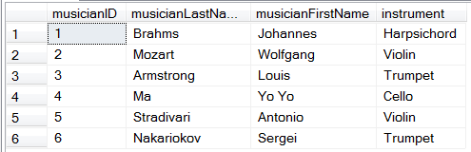
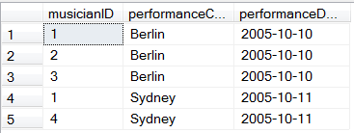
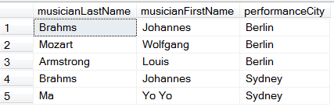
Join Mechanics
SELECT musicianLastName, musicianFirstName, performanceCity
FROM tblOrchestra o JOIN tblMusicianPerformance mp ON o.musicianID = mp.musicianID
Notes:
Consider these two tables.
We can join them on musicianID to find out which musicians played in which concerts.
We can see by inspection that 1,2 & 3 played in Berlin, 1&4 played in Sydney. 5&6 haven’t performed yet.
If we do the query, this is the result
To get this, though, the maths performs two steps

Slide 11
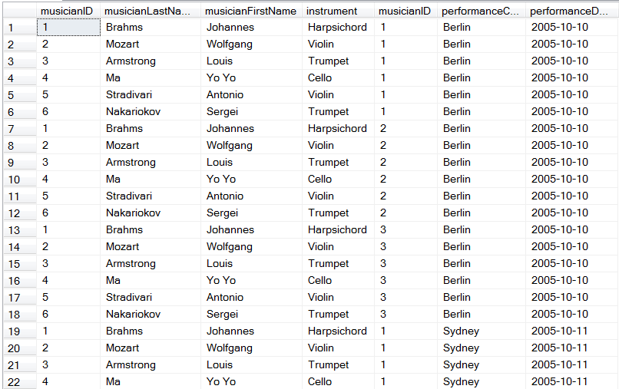
Join Mechanics
Build Cartesian product of the two tables
Notes:
The “cartesian product” is a full cross of the two tables.
Every record in table 1 is connected with every record in table two.
To see how clear it is, how many rows will there be in the cartesian product of tblInstrument and tblOrchestra? (30 = 5 x 6)
This figure shows only part of the table
You see that each row in tblMusicianPerformance is matched with each row in tblOrchestra, in turn
In this arrangement, tblOrch is “fastest moving” and tblMP is “slowest moving”.
You might get the reverse in other queries, but it doesn’t make any difference (remember that in relational algebra, row order is irrelevant)
Then to complete the join, the system looks at the ON condition and chooses those records that satisfy it
In our query it was that the musician IDs were equal, so those records will be returned

Slide 12
Join Mechanics
Choose those records that satisfy the ON condition
Notes:
Then to complete the join, the system looks at the ON condition and chooses those records that satisfy it
In our query it was that the musician Ids were equal, so those records will be returned
Note that tblMusicianPerformance has no records in it with musicianID = 5 or 6. There will therefore be no matches with tblOrchestra on musicianID 5 or 6, so we won’t see those guys in the join, which is as it should be, since they haven’t played in any performances yet.

Slide 13
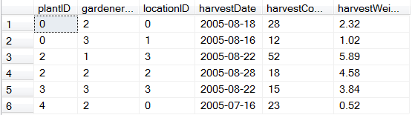
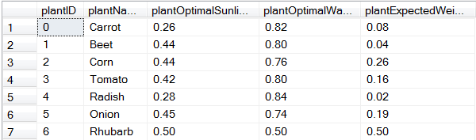
Join Mechanics
Notes:
We could use these two tables to find out the plant for each harvest, as shown on the next slide

Slide 14
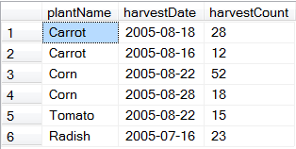
Join Mechanics
Notes:
So what is the intermediate table generated?
How many rows does it have? (42 = 6 x 7)

Slide 15
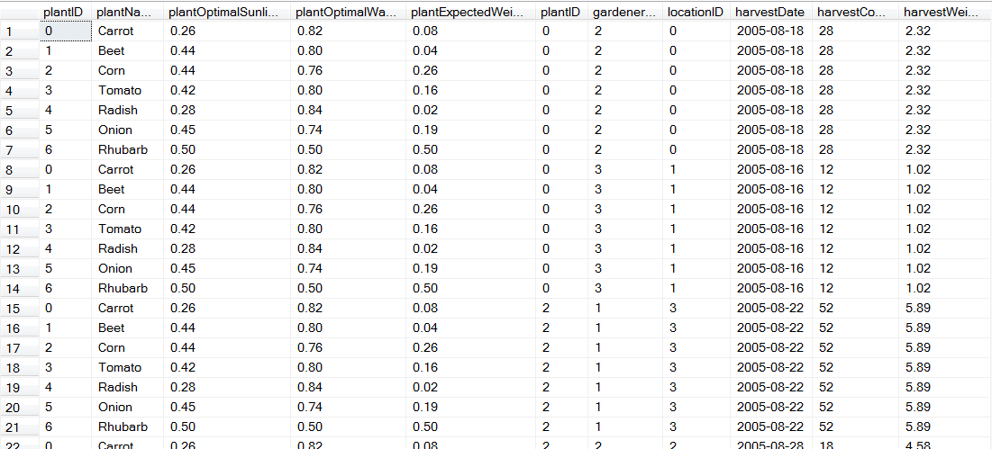
Join Mechanics
Notes:
This is the cartesian product (part of it)
And these are the records that satisfy the ON
Just while we’re here, think about how much work this is for the system.
As we will see, your queries will be more efficient if you reduce the number of records that go into your joins.
This is one of the advanced uses of derived tables (subquery in the FROM)

Slide 16
Outer Joins
Outer Joins return some records from the cartesian product that do not satisfy the ON condition.
In an outer join, the order of the tables is important
FROM tblLeft OUTER JOIN tblRight
Notes:
Order of the tables in a join expression is irrelevant in INNER JOINS, because we make all possible combinations and select only those that satisfy the ON
In outer joins, however, the order determines the output
We refer to the tables as the left and right table depending on their position relative to the OUTER JOIN operator

Slide 17
LEFT OUTER JOIN
Returns every record of the left table
All rows that satisfy the ON condition
For any records in the left table that have no matches, fields from the right table are assigned NULL
Notes:
In an outer join, rows that do not meet the on clause conditions are included in the joined table with null-supplied values for the inner table of the outer join
The matched rows are put into the return set first
Then any records from the left table that haven’t been included are added back into the return set with NULL for all fields from the right table.
WHERE and HAVING are applied as appropriate to this set

Slide 18
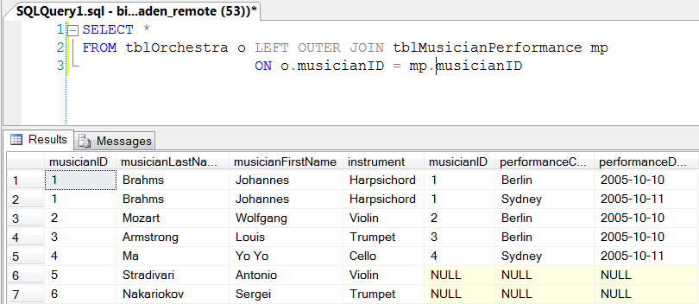
LEFT OUTER JOIN

Slide 19
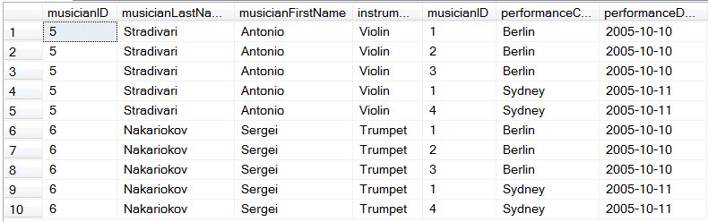
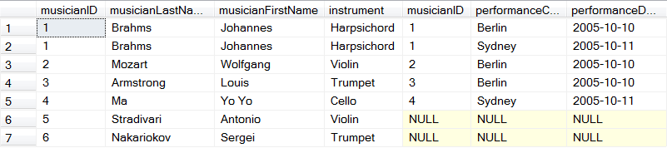
LEFT OUTER JOIN
Notes:
The process is the same – make the cartesian product and grab the matches
But all records in the left table that have no matches get one made up
Here I have selected out those records with Stradivari and Nakariokov. Note that there are no records where the two musicianID fields are equal.
The left outer join takes an instance of each record from the left table and pairs it with nulls on all fields of the right table

Slide 20
RIGHT OUTER JOIN
The right table is the included table.
For unmatched records in the right table, NULL values are supplied for all fields from the left table.

Slide 21
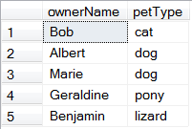
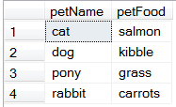

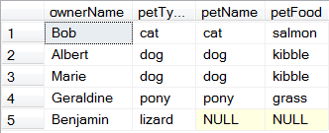
Outer Joins
Notes:
Another example
The cartesian product is made, and all records that satisfy the ON condition are pulled into the result set
That’s the first four records
One record from the left table (#5) has not participated in a selected row
It is thus added back into the result set

Slide 22
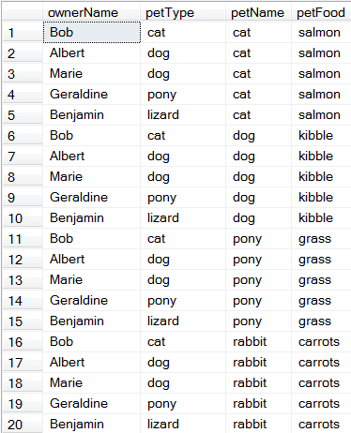
Outer Joins
Notes:
Here is the cartesian product
Here are the records that satisfy the ON condition
But here are the original records from the left table
Note that record 5 has not participated in any of the select records
So it is added back, and nulls are supplied for petName and petFood

Slide 23

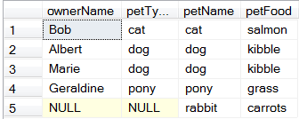
Outer Joins
Notes:
So what will this query return?
All records that match, plus all unmatched records from the right table, that didn’t match, with NULL supplied for the left fields.
You will have noticed that “rabbit” didn’t appear in the LEFT JOIN, and “Benjamin” isn’t in this one

Slide 24
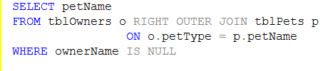

Outer Joins
Uses of Outer Joins
Will always show all records, unlike INNER JOINS which can omit instances completely if there is no match
Valuable for searches on NULL conditions
Notes:
For example, how would you find all the pets that nobody owned?
Something to note here: why not WHERE ownerName = NULL?
NULL is an undefined value, it can never be equal to anything. Two NULLs are not even equal to each other
That is why SQL must provide IS NULL

Slide 25
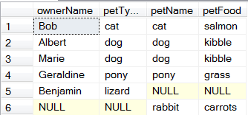
FULL OUTER JOIN
Return set includes
All matched records
All unmatched from the left table with NULL supplied for fields from the right
All unmatched from the left table with NULL supplied for fields from the left
Notes:
The full other join is actually used primarily as a derived table in more complex queries.
We will see some examples later in the term

Slide 26
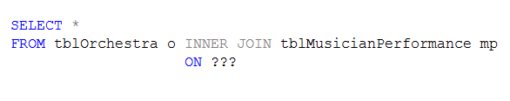
Generating the Cartesian Product
Notes:
If you want to generate the Cartesian Product, what would you put in the ON?
1=1
This operation actually exists, it is called a CROSS JOIN, and has, of course, no ON clause
Also used primarily as a subcomputation for more complex queries

Slide 27
Set Operations
Union
Intersect
Difference
Symmetric Difference
The Select lists of tables involved in any of these operations must reference the same number of elements, of the same data types, in the same order
Notes:
We have said several times that SQL is a set-based language.
Instead of procedural steps, it operates on sets, both logically and practically
Naturally, therefore, it provides the important mathematical operations from traditional set theory

Slide 28
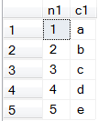
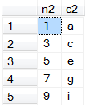
Set Operations
#t2:
#t1:
Notes:
To illustrate how the operations work, we will use these little artificial tables.
Union is all the rows in either table, so {1,2,3,4,5,7,9}
Intersection is rows in both, that is {1,3,5}
Difference(t1,t2) is rows in t1 but not in t2 , so {2,4}
Symmetric difference is rows that are in t1 or t2 but not both, so {2,4,7,9}

Slide 29


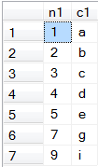
UNION
Contains all elements in either set A or set B
Note:
The column labels are essentially meaningless
Duplicate records are removed
Notes:
You have combined different columns, but there is only one label, so you get the first one. It may be entirely inappropriate
Recall that both #t1 and #t2 had a row (1,a), but it appears only once in the UNION
There is an alternative that does not remove duplicates

Slide 30

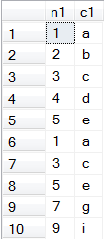
Union
Contains all elements in either set A or set B
Notes:
You have combined different columns, but there is only one label, so you get the first one. It may be entirely inappropriate
Recall that both #t1 and #t2 had a row (1,a), but it appears only once in the UNION
There is an alternative that does not remove duplicates
If you can solve your problem with the UNION ALL version, you should always prefer it. Why is that?
(UNION requires a sort, which is very slow)

Slide 31



Intersection
Contains all elements in both set A and set B
Notes:
You have combined different columns, but there is only one label, so you get the first one. It may be entirely inappropriate

Slide 32



Difference
Contains all that are in A, but not in B
SQL operator is EXCEPT
Not commutative
Notes:
As an exercise, what is t2 EXCEPT t1?
{7,9}

Slide 33

Symmetric Difference
Contains all that are in A, or in B, but not in both
T-SQL does not have this operator.
Can be computed using the available set operations.
Notes:
Can you do it?
Note that the symmetric difference is the UNION minus the INTERSECTION (as you can see in the picture)

Slide 34
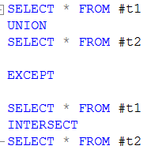
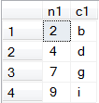
Symmetric Difference

Slide 35
Set Operations
Note that the set operations are not especially common in a single database
They are usually seen in data warehousing applications
Notes:
It is rare to have two tables that have exactly the same format. It would be more likely that the two tables would have been combined at some point with some field to distinguish type
Data warehousing is the science of combining many large disjoint databases and looking for patterns in their data
In these situations, you will be analysing data that came originally from different databases so it is quite likely that you will have different tables with the same structure and data types

Slide 36
CASE
The SQL case statements allows you to embed conditional logic in a query.
There are two formats, called “simple” and “searched”

Slide 37
Simple CASE
CASE input_expression
WHEN value THEN result [ ...n ]
[ ELSE expression ]
END
Notes:
This is from the BOL, and shows the notation they use for syntax
The square brackets mean “an optional thing”
The ...n means “repeat n times”
The italic bits are, as always, placeholders

Slide 38
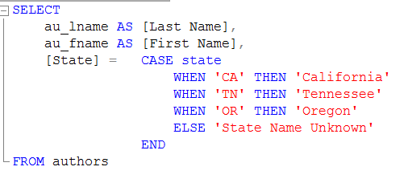
Simple CASE
Notes:
Here is an example of the CASE used in a SELECT, which is quite common
We take au_lname and au_fname and give them nice column names
For the state, we use the alternative syntax for column header creation, and use a CASE on the right hand side of the equal
The CASE switches on the state (ignore the pretty print there, it’s just because state is a keyword)
There is a WHEN for each value you want to catch, and a THEN for the value to supply
The ELSE is the default
The END is required
Once this is done, you specify the table as per usual

Slide 39
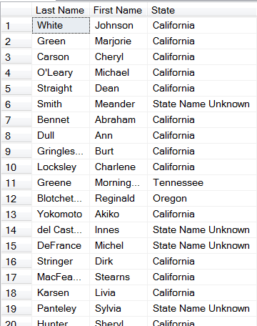
Simple CASE
Notes:
This is the partial table

Slide 40
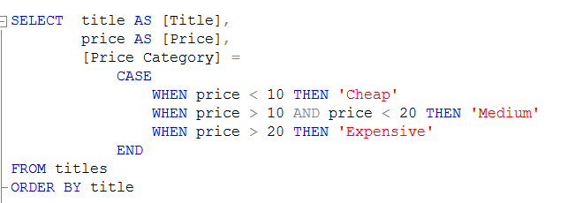
Searched CASE
Notes:
No switch target (i.e. CASE “something”)
Essentially a shorthand for multiple if-elses

Slide 41
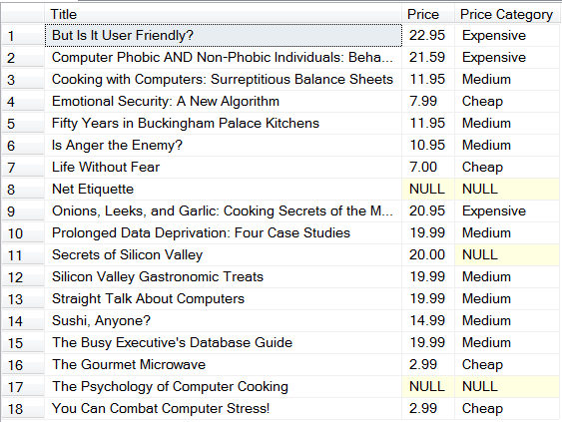
Searched CASE
Notes:
Case can also occur in UPDATE, DELETE, INSERT and HAVING.
Anywhere that you would specify a value, you can use a CASE statement to specify that value conditionally
Further practice left to you as an exercise

Slide 42
CASE
www.4guysfromrolla.com/webtech/102704-1.shtml

